Slide 1



Statistical prediction of injuries on CREPS athletes
Hugo Lelievre, Alexia Grenouillat, Yasser Afifi (4A GMM)
Tutors : Marine Gargagli and Thomas Baudry
1

Slide 2
Summary
Presentation of the dataset
Main goals of the CREPS project
Preliminary data processing
Models used and explanation
Comparison criteria
Models selection
R interface for coaches
Conclusion
2

Slide 3








The dataset
119 individuals from 8 different sports
14 TM2S variables
Grouping TM2S variables into categories
Other variables:
Sport, new/old in CREPS, past injuries and current pain
Removal of asymmetry variables
3

Slide 4
Main goals of the CREPS project
Construction of a statistical model to understand the underlying mechanisms of injury in high-level athletes
Extend this model to predict targeted injuries based on body areas
Find the variables of importance to explain injuries
Estimate the unavailability of athletes in case of injury for each body area
Provide CREPS staff with an interpretable decision support tool
4

Slide 5



Preliminary data processing
Reorganize the entire database: merge the different files and put them in a format interpretable by R
Due to the poor size of the database, we decided to:
Transform response variables into binary ones (Injured / Not injured)
Define 3 body areas : Lower Limb, Upper Limb and Spine / Torso
Tests of independence to determine whether a variable is relevant to predict athletes' injuries (if an explanatory variable is independent of an injury, it is useless in the model)
5

Slide 6
Models used and explanation
Selection/clustering of variables
LASSO selection: the number of variables is large compared to the number of individuals, so selecting variables improves the models
ClustOfVar: group similar variables into clusters, and use these clusters as new variables
Machine learning prediction methods
Logistic model: the most commonly used for the prediction of a binary variable
CART trees: visual, interpretable, easy-to-use
Random forest: overcomes the lack of robustness of trees and improves prediction
Naive bayes: simple and relevant for our database
6

Slide 7
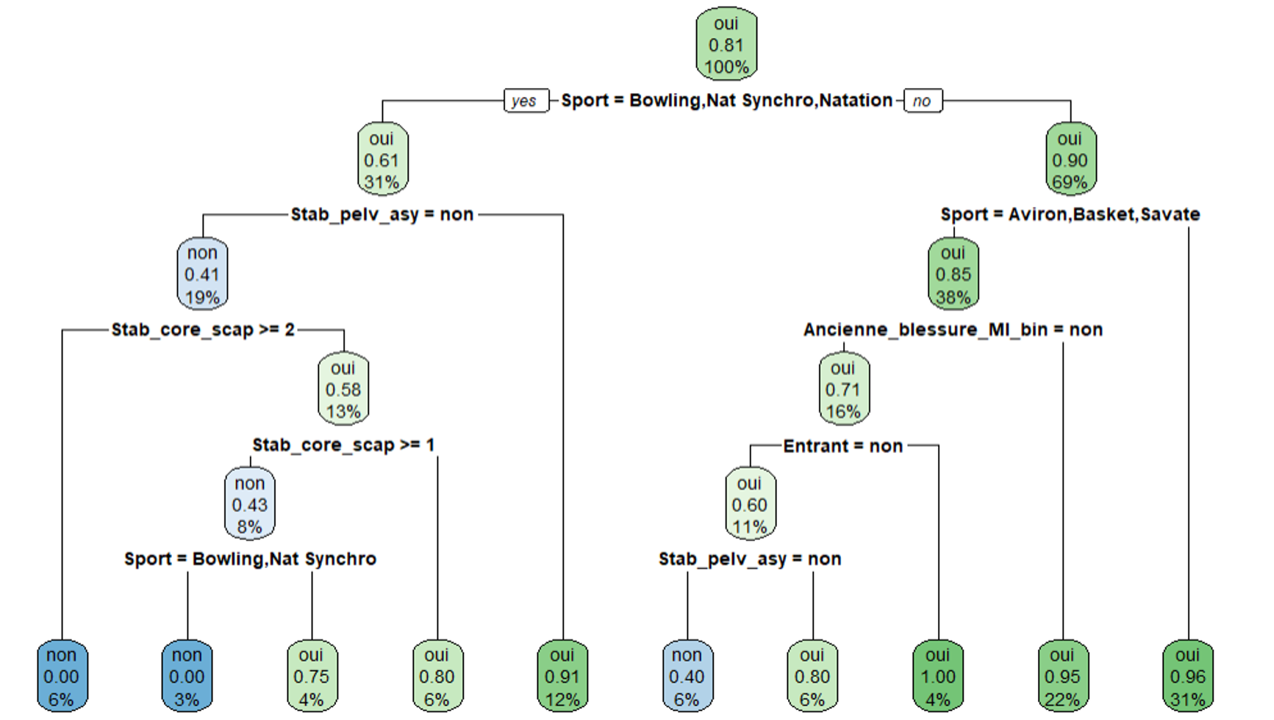
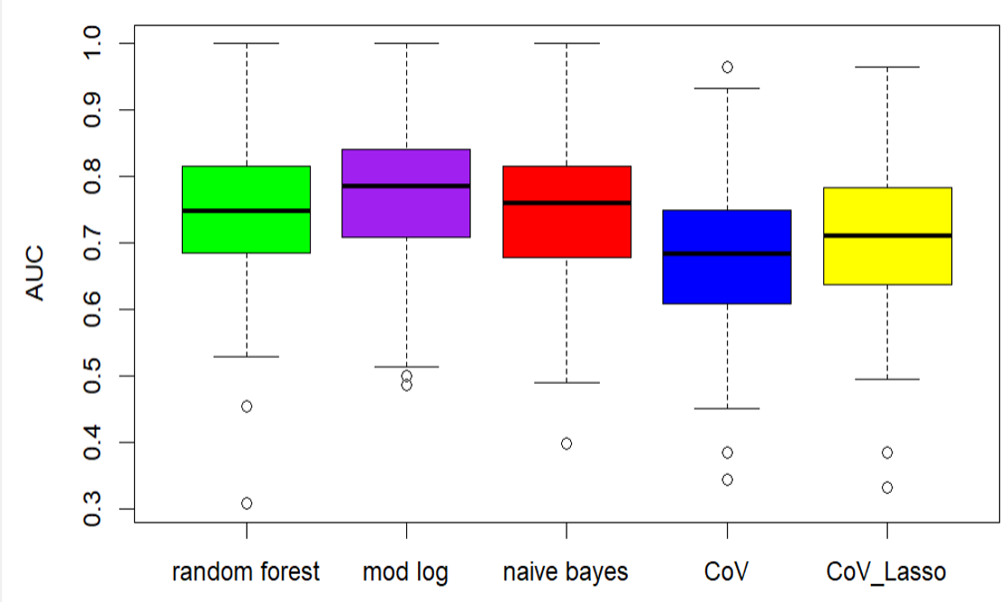
Boxplots of the linear model combined with LASSO, CoV and CoV + LASSO
Exemple of a classification tree
7

Slide 8
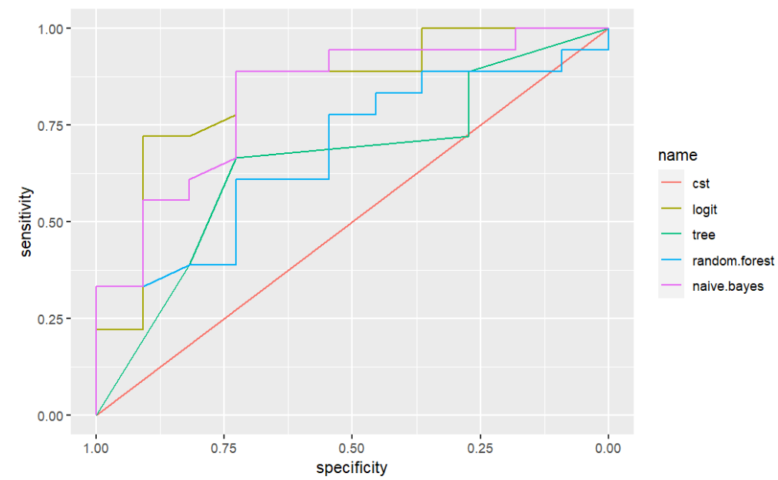

Comparison criteria
ROC curves and Area Under the Curves (AUC) : adapted to binary classification
ROC curves
Monte Carlo cross-validation to overcome the poor size of the CREPS dataset
Creation of 3 classes of prediction:
[0;0.3], [0.3;0.7], [0.7;1]
Not injured
Incertain
Injured
Models' comparison in function of AUC, good predictions rate and the number of "uncertains"
8

Slide 9
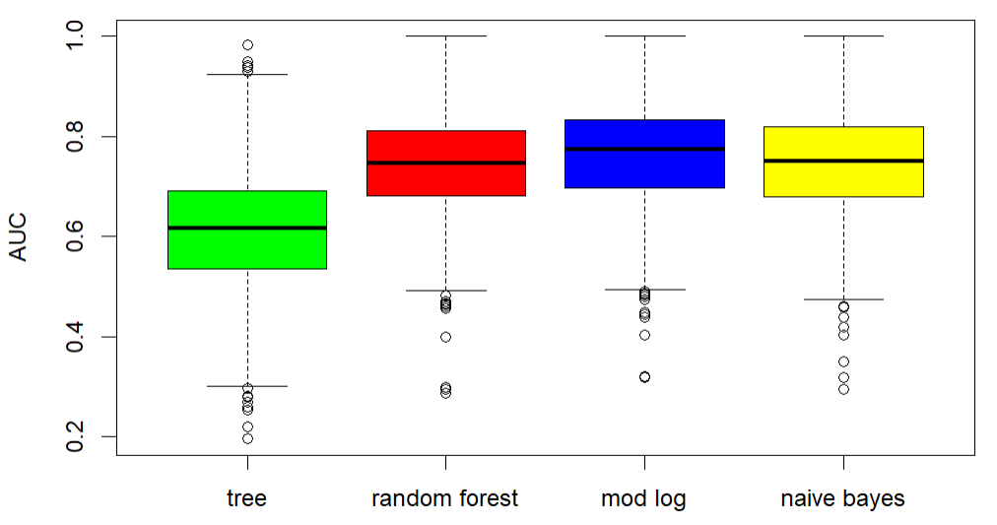
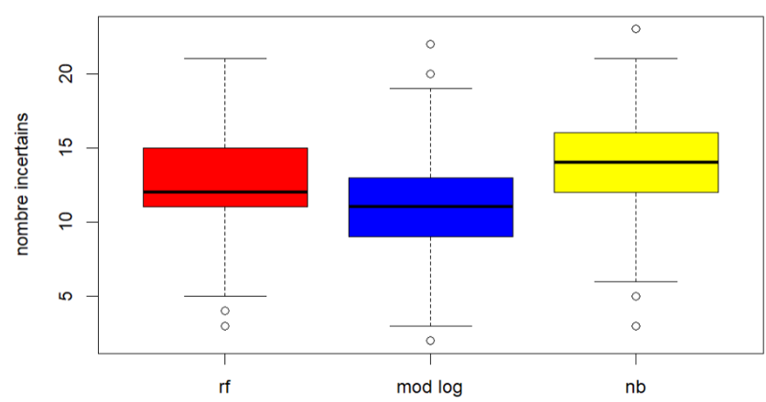
Models selection
AUC boxplots of regression tree, random forest, logistic regression and naive bayes
Boxplots of “uncertains” for the prediction of LL injury
9

Slide 10
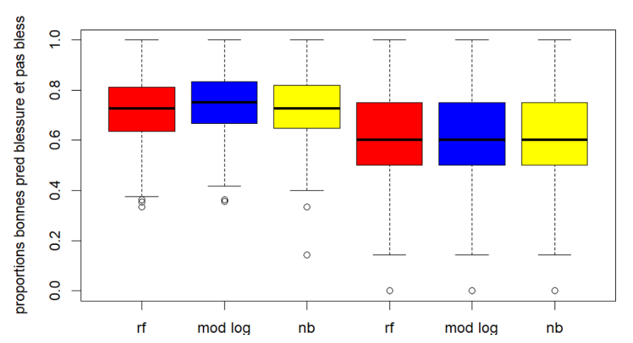
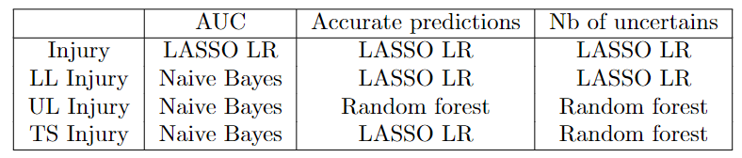
Boxplots of correct predictions for LL Injury and No LL injury
Best model depending on the type of injury and the estimator used
10

Slide 11
R Interface for coaches
Our main objective was to build a statistical model to predict injuries; however, this model must be reusable a posteriori by CREPS coaches.
Nothing more to code
Easy-to-read
What the interface must provide :
Customizable for each athlete
Probabilities of injury that change in real time
Predictions that will improve as the excel files fill up
11

Slide 12
Conclusion
Predict athlete’s injuries and evaluate the duration of unavailability
Provide coaches with an R interface
Thanks to machine learning algorithms and statistical models, we can predict each type of injury correctly between 60 and 80%
Coaches can use the Interface thanks to its simple design and without particular skills. Hopefully, they will be able to use it on new athletes
Decision support tool for our supervisors. Predictions are not an end in themselves; they will assist coaches to help them decrease the risk of injury of an athlete (corrective routines, adaptation of motions …)
12

Slide 13
Conclusion
Difficulties we had to overcome
Poor size of the dataset
Most of the variables are qualitative, then harder to exploit than quantitative ones
Impossibility to fit prediction models for downtime (some athletes had several injuries on the same part of the body, but their unavailability was not the same for each injury)
Bias in the TM2S exercises and scores
May not be independent two at a time
We used the results obtained at the beginning of the 2020-2021 season; corrective routines are then not taken into account
13

Slide 14
Thanks for listening !
14

